Slide 1
CLASS -10
CHAPTER - 7

Slide 2
INSTRUCTIONS FOR TEACHERS
Whenever you see a hand instead of an arrow while moving the mouse, you need to click on it, it could be a link to any important video, image, sound etc.
A home page symbol is given at the extreme right hand corner of each slide . Clicking the home icon would lead you to Home page from where you can access and show any specific slide/topic of the lesson.
A book link has been given on each slide next to the home icon. On clicking it, NCERT book will open.
The hyperlink to the videos have been given to a specific images of camera/ television/cameraman etc. next to the book icon on slides as per the requirement.
In case the hyperlink is not working, you can show important videos form the raw material folder titled as videos. During slideshow, Press F1 for help.

Slide 4
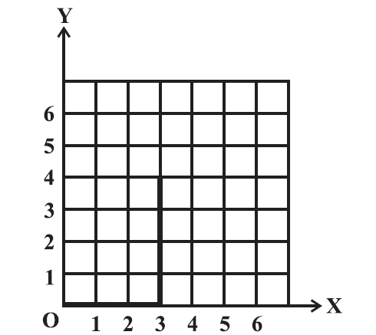
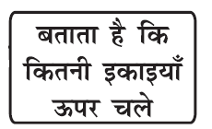

Slide 5
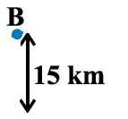

Slide 6
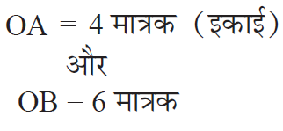

Slide 10
( -5 , 4 )

Slide 11
Y
O
X

Slide 13
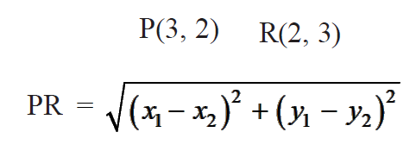
उदाहरण :
हल :

Slide 14
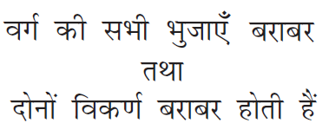
उदाहरण :
हल :

Slide 15
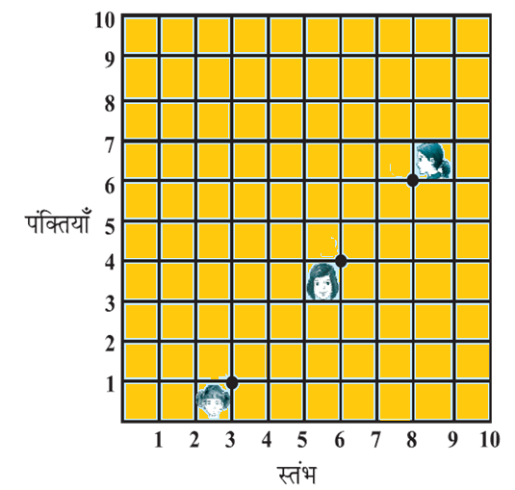
उदाहरण :

Slide 16
हल :

Slide 17
उदाहरण :
हल :

Slide 18
उदाहरण :
हल :

Slide 19
FOR EXERCISE PLEASE REFFER TO BOOK

Slide 20
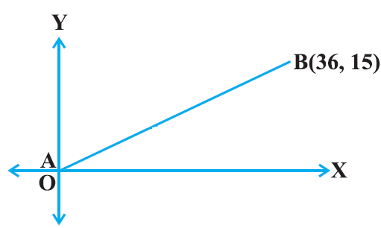
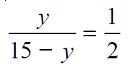

Slide 21
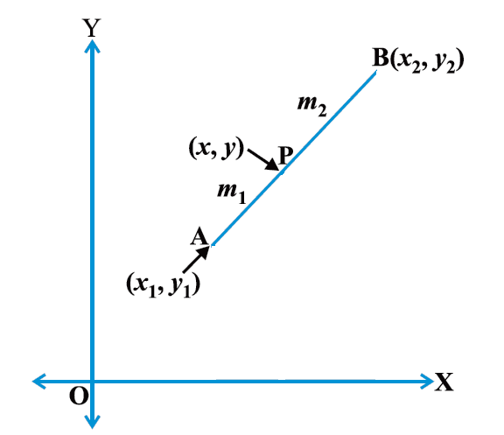
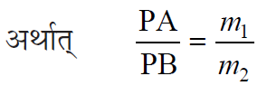

Slide 22
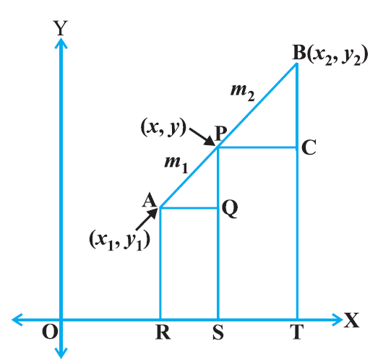
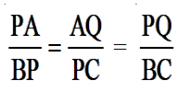

Slide 26
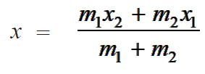
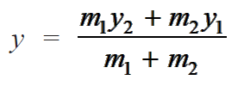
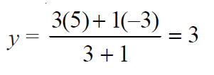
उदाहरण :
हल :

Slide 27
उदाहरण :
हल :

Slide 28
उदाहरण :
हल :
=
=
=
=

Slide 29
उदाहरण :
हल :

Slide 30
उदाहरण :
हल :

Slide 31
FOR EXERCISE PLEASE REFFER TO BOOK

Slide 33
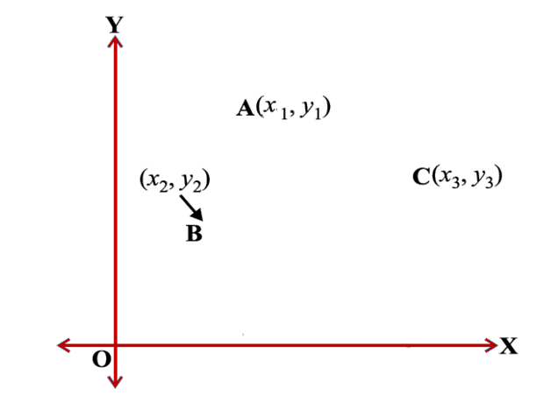
=

Slide 34
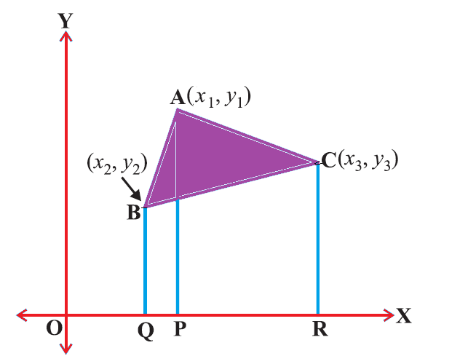

Slide 35
उदाहरण :
हल :

Slide 36
उदाहरण :
हल :

Slide 37
उदाहरण :
हल :

Slide 38
उदाहरण :
हल :

Slide 39
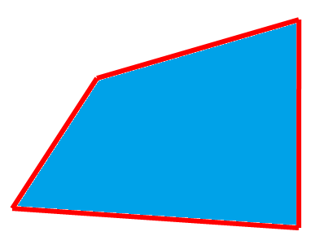
उदाहरण :
हल :

Slide 40
FOR EXERCISE PLEASE REFFER TO BOOK

Slide 41
THANK YOU

