Slide 6
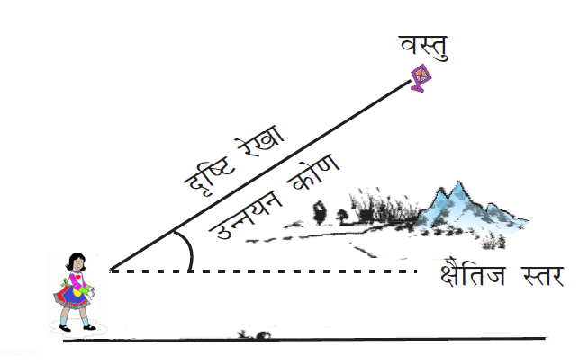

Slide 7
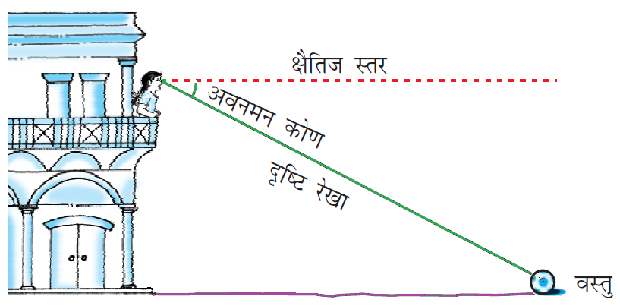

Slide 10
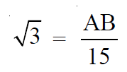

Slide 11
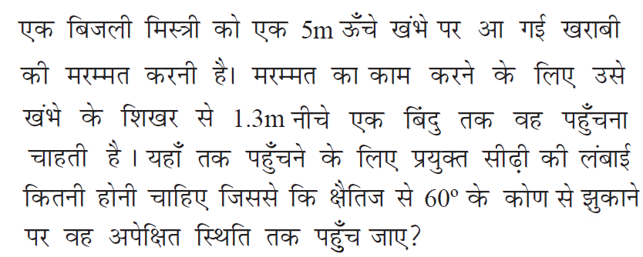
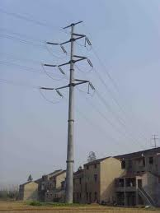

Slide 12
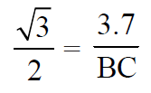
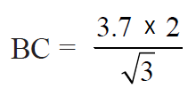

Slide 13
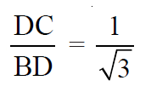
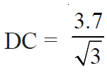

Slide 14
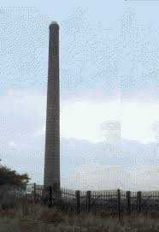
A
D
E
B
C

Slide 15
A
D
E
B
C

Slide 16
D
B
P
A

Slide 17
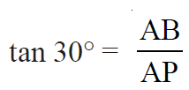
D
B
P
A

Slide 18
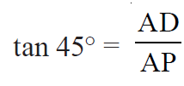
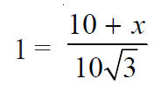
D
B
P
A

Slide 19
A
B
D
C

Slide 20
A
D
B
C

Slide 21
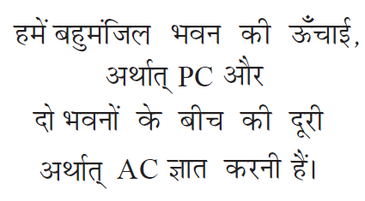
P
B
A
C

Slide 22
Q
P
B
D
A
C

Slide 23
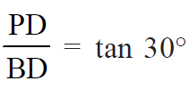
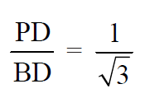
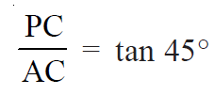
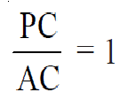
Q
P
B
D
A
C

Slide 24
Q
P
B
D
A
C

Slide 25
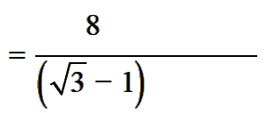
Q
P
B
D
A
C

Slide 26
Q
P
B
D
A
C

Slide 27
P
A
D
B

Slide 28
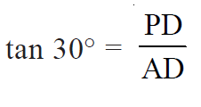
P
A
D
B

Slide 29
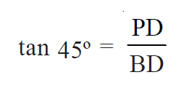
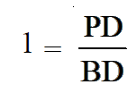
P
A
D
B

Slide 30
FOR EXERCISE PLEASE REFFER TO BOOK

Slide 32
REFERENCES
http://www.animationlibrary.com
http://www.animationsplayhouse.com
http://www.heatheranimations.com
http://www.ilovewavs.com
http://www.images.google.co.in
http://www.youtube.com
NCERT BOOKS

