Slide 1
CONSTRUCTIONS

Slide 2
INSTRUCTIONS FOR TEACHERS
Whenever you see a hand instead of an arrow while moving the mouse, you need to click on it, it could be a link to any important video, image, sound etc.
A home page symbol is given at the extreme right hand corner of each slide . Clicking the home icon would lead you to Home page from where you can access and show any specific slide/topic of the lesson.
A book link has been given on each slide next to the home icon. On clicking it, NCERT book will open.
The hyperlink to the videos have been given to a specific images of camera/ television/cameraman etc. next to the book icon on slides as per the requirement.
In case the hyperlink is not working, you can show important videos form the raw material folder titled as videos. During slideshow, Press F1 for help.

Slide 4
A
B
X

Slide 5
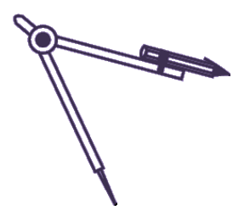
A
B
X

Slide 6
A
B
X

Slide 7
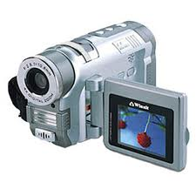
C
A
B
X

Slide 8
A
B
X

Slide 9
Y
A
B
X

Slide 10
Y
A
B
X

Slide 11
Y
A
B
X

Slide 21
FOR EXERCISE PLEASE REFFER TO BOOK

Slide 22
P .
. O

Slide 23
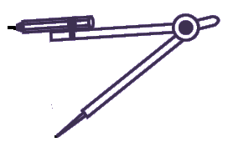
P .
M
. O

Slide 24
Q
P .
M
. O
R

Slide 25
Q
P .
M
. O
R

Slide 26
FOR EXERCISE PLEASE REFFER TO BOOK

Slide 28
REFERENCES
http://www.heatheranimations.com
http://www.images.google.co.in
http://www.ncert.nic.in
http://www.youtube.com
NCERT BOOKS

