Slide 1
Click here
( for teachers )

Slide 2
हमें क्या सीखना हैं I
INSTRUCTIONS FOR TEACHERS

Slide 4
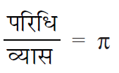

Slide 5
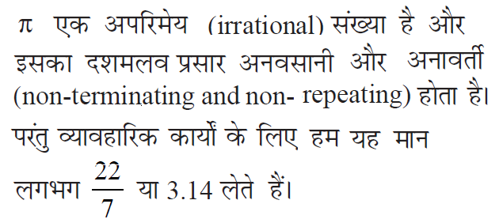

Slide 6
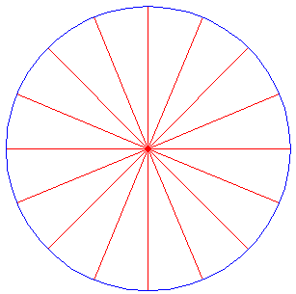

Slide 9
कार की चाल=66 किलोमीटर प्रतिघंटा
=66 x1000 /3600
= 330 /18
=55 /3 मीटर प्रतिसेकंड
समय =10 मिनट
=10x60
= 600 सेकंड

Slide 10
कार के द्वारा तय की गई दुरी = चाल x समय
=55 /3 x 600
= 11000 मीटर
पहिये का ब्यास =80 सेंटीमीटर
पहिये की त्रिज्या = 1/2x80 सेंटीमीटर
= 40 सेंटीमीटर
=40 /100 मीटर
=2/5 मीटर

Slide 11
पहिये की परिधि = 2πr (r वृत्त की त्रिज्या & π=22 /7 )
=2x 22/7 x 2/5
=88/35 मीटर
पहिये के द्वारा लगाये गए चक्कर =11000 /(88 /35)
=11000x35 /88
For more question refer to Ex. 12.1 of ncert
=35000 /8
= 4375
पहिये के द्वारा लगाये गए चक्कर=4375

Slide 12
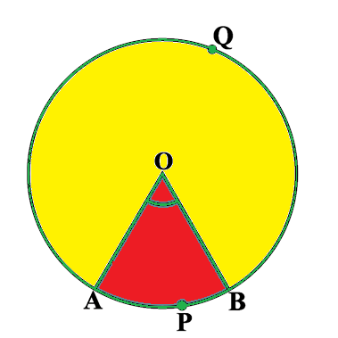

Slide 13
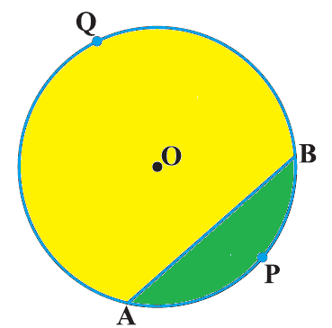

Slide 14
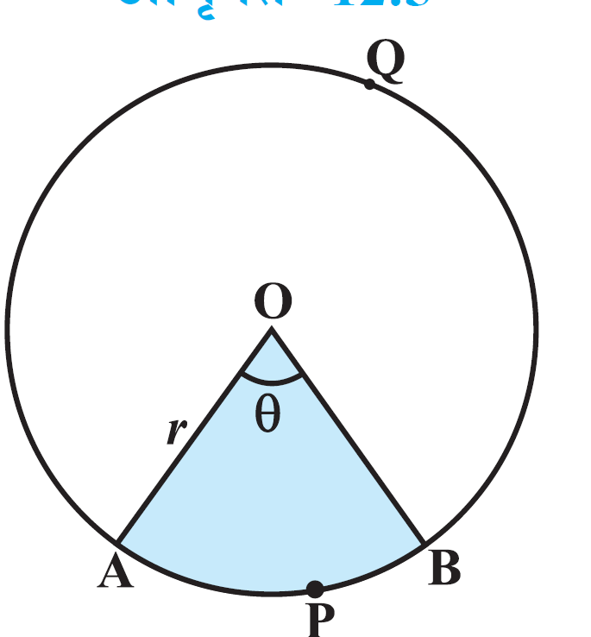

Slide 16
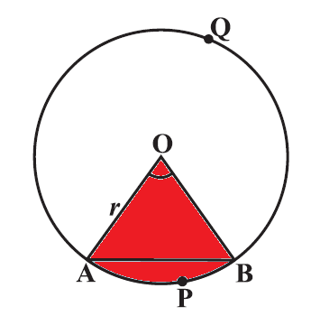

Slide 17
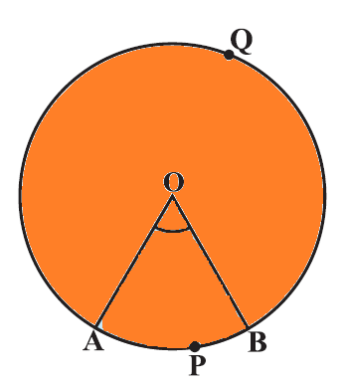
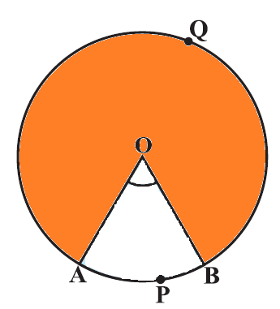
=

Slide 18
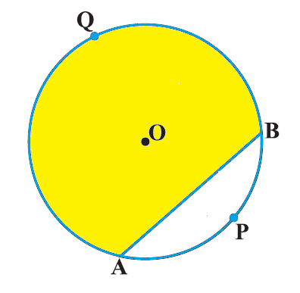
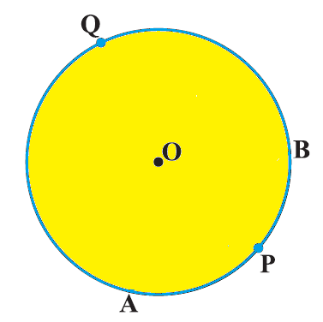

Slide 19
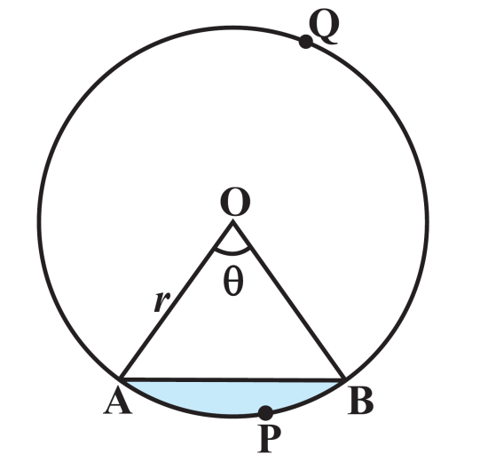

Slide 20
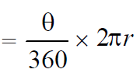

Slide 21
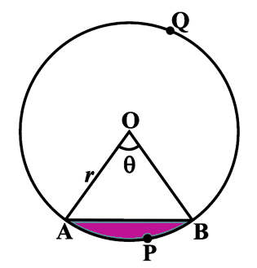
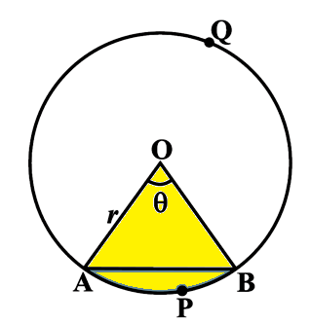

Slide 22
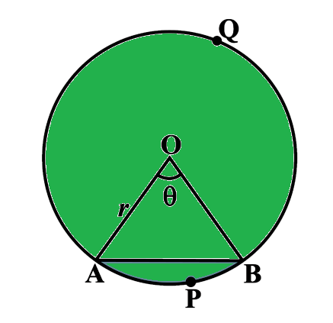
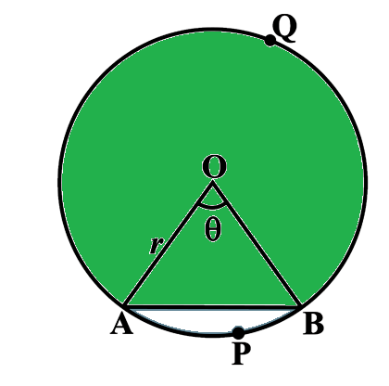

Slide 23
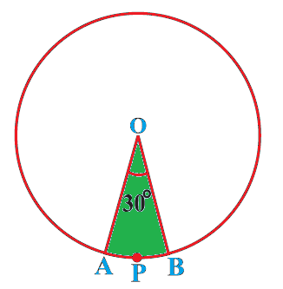

Slide 24
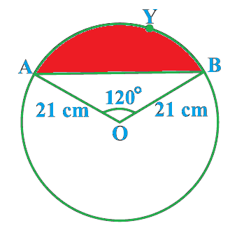

Slide 26
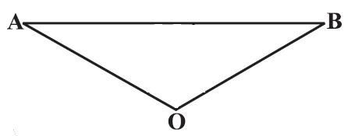

Slide 27
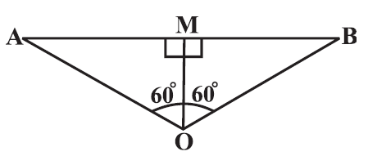
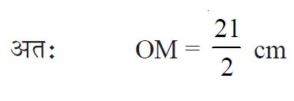
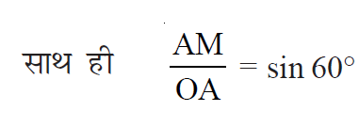
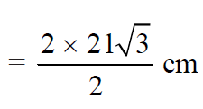

Slide 28
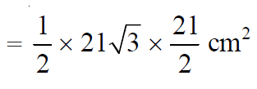

Slide 29
FOR EXERCISE PLEASE REFFER TO BOOK

Slide 30
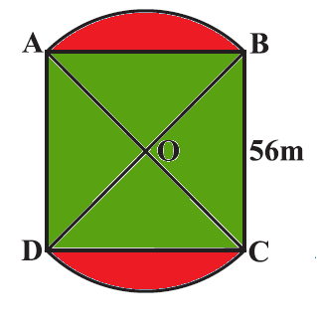

Slide 31
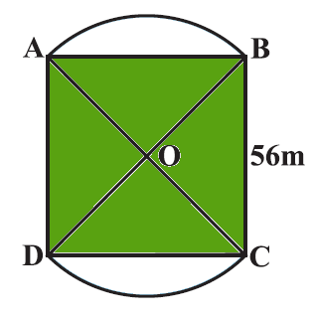

Slide 35
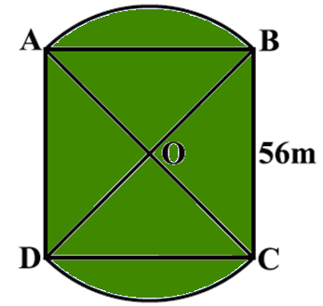
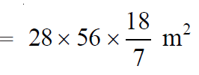

Slide 36
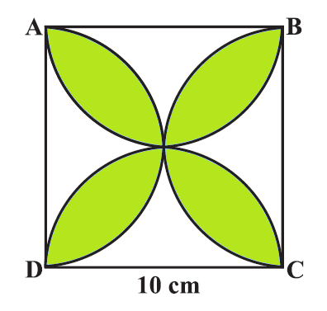

Slide 39
FOR EXERCISE PLEASE REFFER TO BOOK

Slide 41
INSTRUCTIONS FOR TEACHERS
Whenever you see a hand instead of an arrow while moving the mouse, you need to click on it, it could be a link to any important video, image, sound etc.
A home page symbol is given at the extreme right hand corner of each slide . Clicking the home icon would lead you to Home page from where you can access and show any specific slide/topic of the lesson.
A book link has been given on each slide next to the home icon. On clicking it, NCERT book will open.
The hyperlinks to the videos have been given to a specific image of camera/ television/cameraman etc. next to the book icon on slides as per the requirement.
In case the hyperlink is not working, you can show important videos form the raw material folder titled as videos.
During slideshow, Press F1 for help.

