Slide 1
कक्षा -10
अध्याय-15

Slide 2
हमें क्या सीखना है
For Teachers
Click on the topic

Slide 8
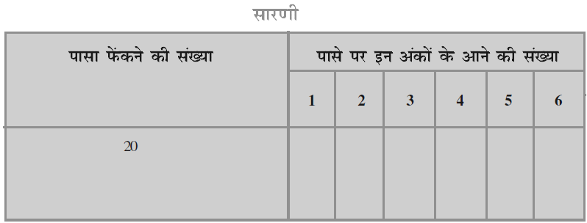

Slide 25
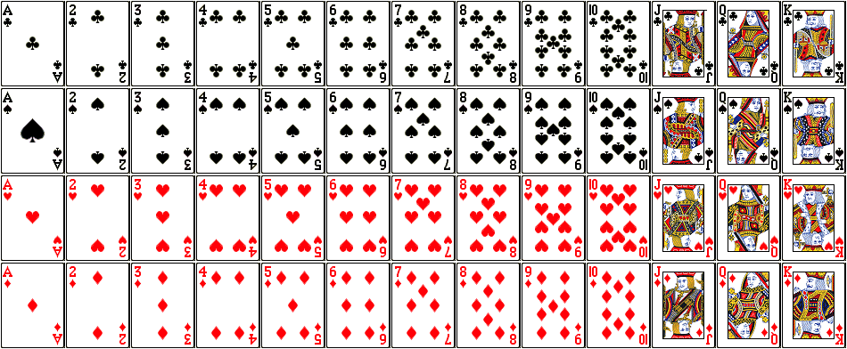

Slide 27
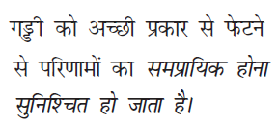

Slide 29
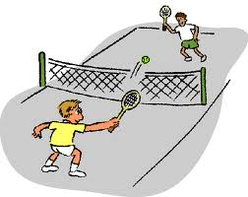

Slide 37
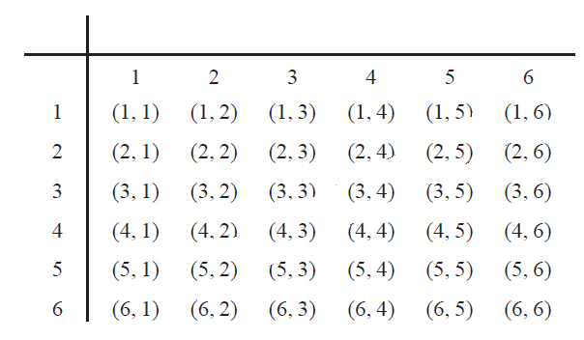

Slide 40
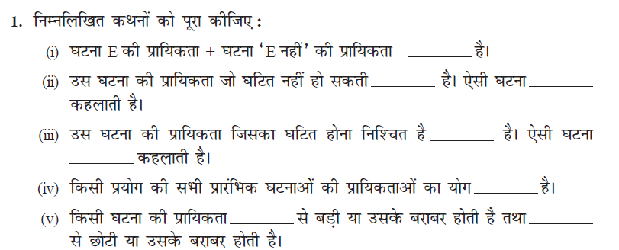
1
0
1
1
0
1

Slide 42
For more exercise questions refer to book

Slide 43
सारांश
1
2
3
4
5
6

Slide 45
INSTRUCTIONS FOR TEACHERS
Whenever you see a hand instead of an arrow while moving the mouse, you need to click on it, it could be a link to any important video, image, sound etc.
A home page symbol is given at the extreme right hand corner of each slide . Clicking the home icon would lead you to Home page from where you can access and show any specific slide/topic of the lesson.
A book link has been given on each slide next to the home icon. On clicking it, NCERT book will open.
The hyperlink to the videos have been given to a specific images of camera/ television/cameraman etc. next to the book icon on slides as per the requirement.
In case the hyperlink is not working, you can show important videos form the raw material folder titled as videos.
During slideshow, Press F1 for help.

Slide 46
REFERENCES
http://www.animationlibrary.com
http://www.animationsplayhouse.com
http://www.heatheranimations.com
http://www.ilovewavs.com
http://www.images.google.co.in
http://www.ncert.nic.in
http://www.youtube.com
NCERT BOOKS

