Slide 5
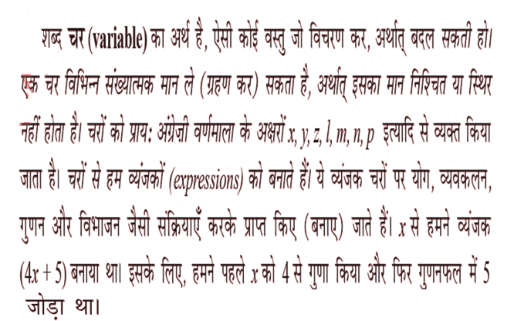
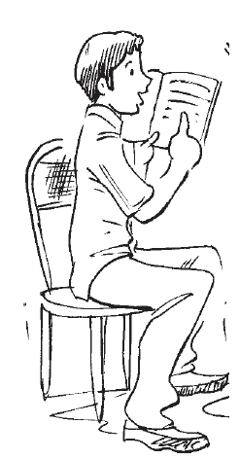

Slide 6
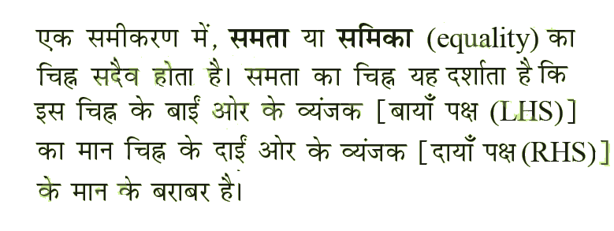

Slide 7
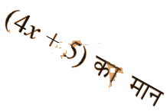

Slide 8
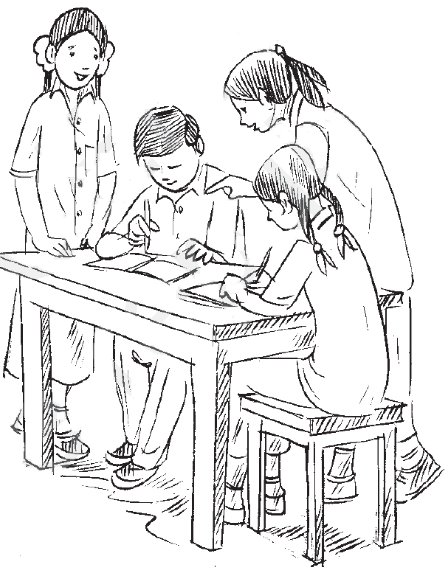

Slide 12
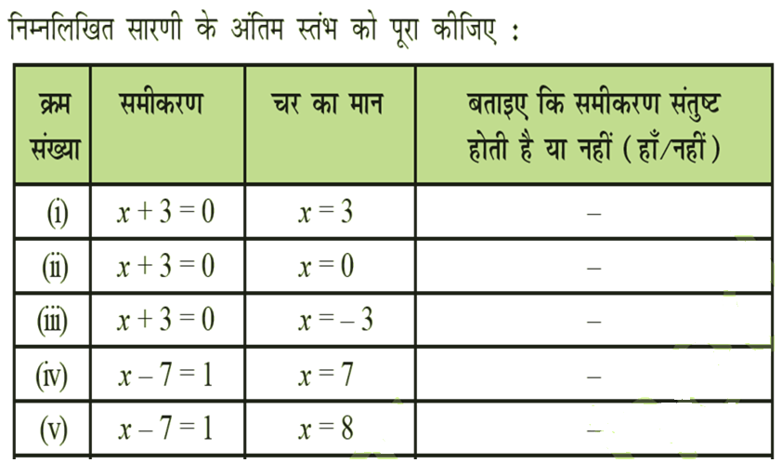

Slide 13
-1
1
5x-1+2=-3
3
5x1+2=7
2
NO
NO
5x3+2=17
5x2+2=12
Yes!!!!
NO
-2
5x(-2)+2=-8
NO

Slide 15
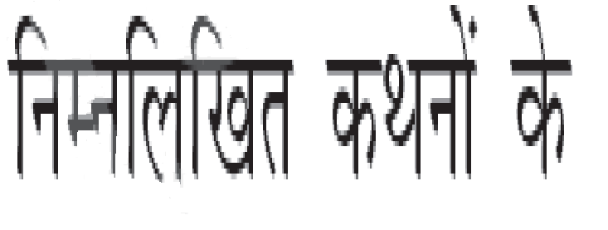
X + 4 = 9
Y – 2 = 8
10 a = 70
= 6

Slide 17
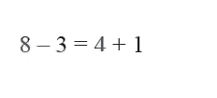
8 - 3
+2
8 – 3
-2
=
4+1
-2
=
4+1
+2
3=3
7=7

Slide 18
8 – 3 = 5
4 x
4 x
(
8 – 3 = 5
)
20 = 20
1=1

Slide 19
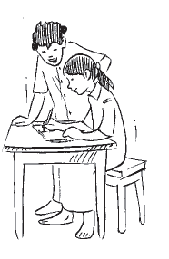
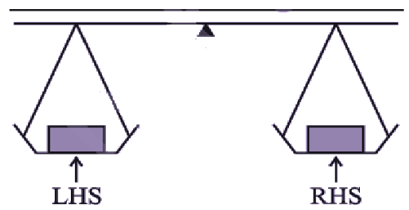

Slide 21
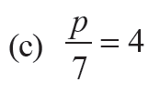

Slide 22
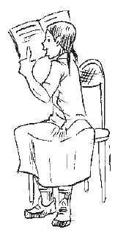

Slide 26
=
=
=
(
+
5
)
+
5
=

Slide 27
-5
-5
= 39
=

Slide 29
7x +50+40=300
7x+90=300
7x=300-90
7x=210
x=30
?
X 7
+
50
+
40
=
300
= 30

Slide 30
THaNKS

