Slide 1
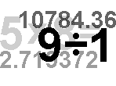
अध्याय-15
कक्षा -9

Slide 2
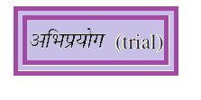
हमें क्या सीखना है
Click on the topic

Slide 6
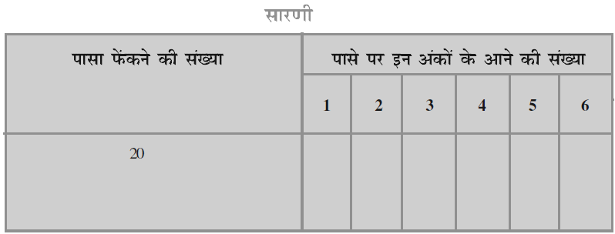

Slide 11
A trial is an action which results in one or several outcomes

Slide 12
An event for an experiment is the collection of some outcomes of the experiment.

Slide 13
Click on TV

Slide 18
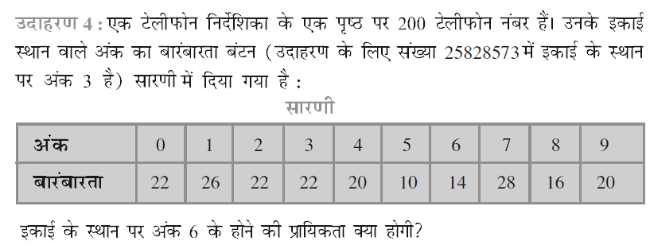

Slide 21
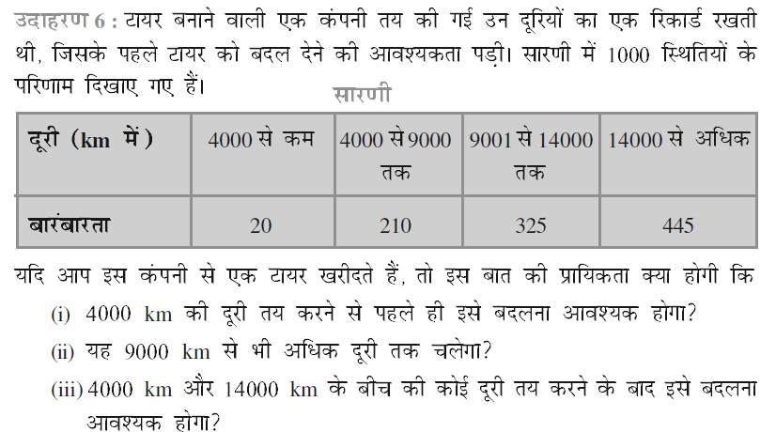

Slide 23
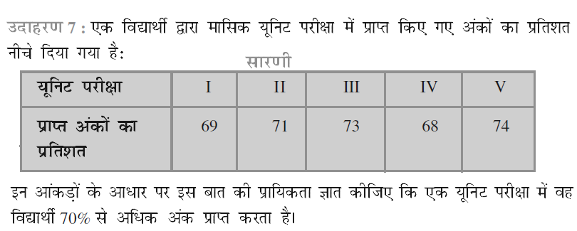

Slide 26
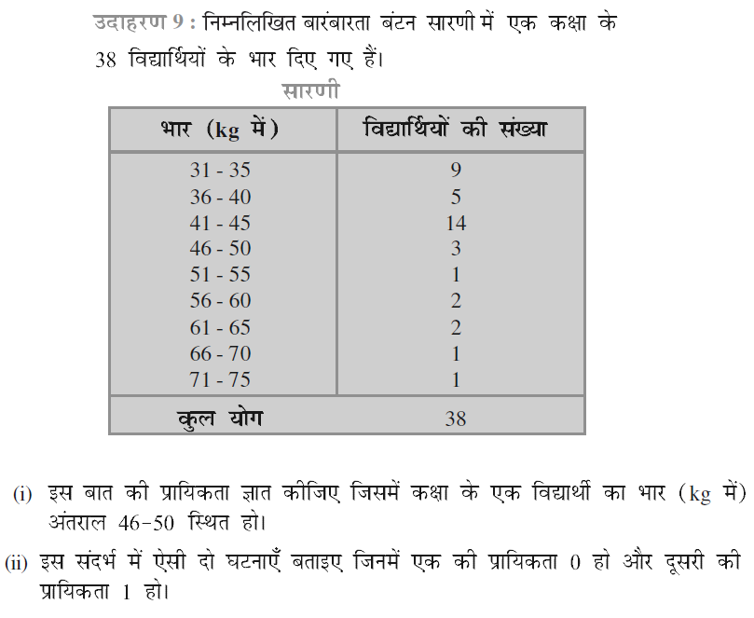

Slide 30
Click on TV

Slide 33
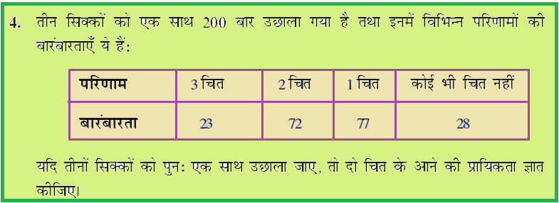

Slide 40
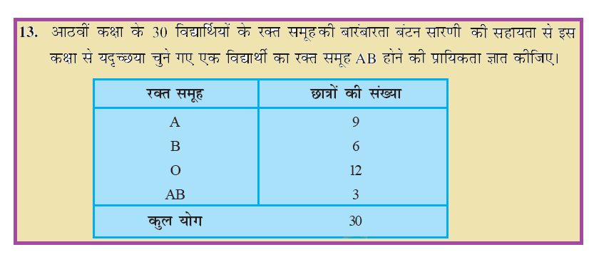

Slide 41
THE END
We love math!!!!!!!!!!

